Slide 1

2025, an exceptional year ?
YTD September 14th 2025 review
October 9th, 2025

Slide 2



Toys & Games market get back to growth +9% in value and even outpace EU average growth rate
VALUE
UNIT
PRICE
+9%
(-1% YTD’24 vs 23)
+5%
(+4% YTD’24 vs 23)
+4%
(17€)
+7%
+3%
+4%
(14€)
Source: Circana | Retail Tracking Service | EU7 | YTD W37 2025
EU7: NL,BE,FR,UK,SP,IT,GE

Slide 3
Toys & Games capture all pre-seasonal calendar events!
Weekly sales €M
-8%
W3-6
+6%
Easter
(2 weeks )
+18%
Mother day
+23%
Father day +
Aid el Kebir
+7%
Summer Holidays
+16%
Summer Holidays W2
+19%
Back to School
Source: Circana | Retail Tracking Service | Belgium | YTD W37 2025

Slide 4

Top Toys & Games tailwinds
Last year market boosters continue to drive Toys & Games industry
Kidults
Collectibles
Manga
45/100
+38%
+79%
Top 100 items sold in value are for Kidults
Pokemon, Funko Pop!, LEGO minifigurines etc
Pokemon, Beyblade, One Piece, Yu-Gi-Oh
etc
Source: Circana | Retail Tracking Service | Belgium | YTD W37 2025

Slide 5


Attractivity through newness
+89%
YoY
Source: Circana | Retail Tracking Service | Belgium | YTD W37 2025
Circana, LLC | Proprietary and confidential

Slide 6





…and license
Still potential
+19%
YoY
#1 #2 #3
Source Circana Retail Tracking Service, France, YTD (Jan 01 2024 - Sep 29 2024)
Circana, LLC | Proprietary and confidential
Source: Circana | Retail Tracking Service | Belgium | YTD W37 2025

Slide 7

All price points are dynamic!
Market valorisation: +50€ accounted for 28% sales (+2pts YoY)
Price Points €% - YTD 2025
Evol €% YoY
0-20€
1/3
.
3/4
.
of € Sales
of Unit Sales
Source: Circana | Retail Tracking Service | Belgium | YTD W37 2025
Notes:
0-20€ is 1/3 of value sales but 75% (3/4) of the units solds

Slide 8

Both Channels display value growth , Online 1/3 sales
Channel value weght
Evol € % YoY
Source: Circana | Retail Tracking Service | Belgium | YTD W37 2025
<numéro>
Notes:
Value: 1/3
Volume 80% B&M

Slide 9
Over 80% growth come from Building Sets and Games
5 supercategories are growing out of 11 (vs 3 last year)
Supercategories (€%)
Gains/losses YoY €M
%Chg
+31%
+28%
+3%
-3%
-13%
-18%
-2%
-5%
+21%
+6%
-10%
Source: Circana | Retail Tracking Service | Belgium | YTD W37 2025

Slide 10

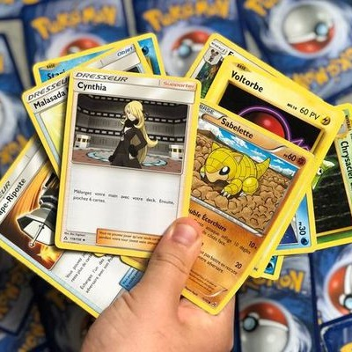



Top gaining subclasses
Top Gaining subclasses YOY (€)
+32%
+110%
+49%
+43%
+8%
Std Building Sets
STCG
Action Figure Collectibles
Pools
Traditional Plush
Source Circana Retail Tracking Service, Belgium, YTD W37 2025

Slide 11










Toys & Games growth is not limited to LEGO and Asmodee
Top Gaining Manufacturers outside LEGO & Asmodee
Top 100 Corp. Manufacturers
60/100
are gaining sales YoY
Source Circana Retail Tracking Service Belgium, YTD W37 2025

Slide 12

What hypothesis for Q4?
Regardless of Q4 scenario, full year 2025 will be a record year for the Toy & Games industry
Q4 performance scenarios on full year 2025 trend
2024
Q4’25:
Q4’25:
Q4’25:
2024:
Q1-Q3
-0,3%
Q1-Q3
+8,8%
Q4
-0,6%
Q4
+4%
Q4
0%
Q4
-4%
2024
-0,4%
2025
+6,6%
2025
+4,7%
2025
+3%
Source: Circana, Retail Tracking Service, France, YTD W37 2024

Slide 13

Merci
Dank u

Slide 14

Speakers
Nicolas PONS
Retail Europe Deputy
nicolas.pons@circana.com
Notes:
I am Nicolas Pons and with Marianne, we'll be presenting the key trends for 2023 and Q4.
Any specific questions or in-depth analysis on a category or a license don't hesitate to contact us and we'll answer your questions.

